Slide 1

Diamond Price Prediction
Presented by:
Under the Guidance of:
2

Slide 2
Agenda
Abstract
Introduction
Technologies Learnt
System Requirements and Specifications
System Design
Implementation
Conclusion

Slide 3
ABSTRACT
Predicting diamond prices accurately is crucial in various industries, including jewellery retail, diamond trading, and investment analysis.
Traditional methods of price estimation often rely on subjective assessments by experts and historical market trends.
Diamond price prediction is crucial for various stakeholders in the diamond industry as it facilitates informed decision-making, risk mitigation, and market efficiency.
Accurately forecasting diamond prices, retailers can optimize inventory management, ensuring they stock the right diamonds at the right prices to meet customer demand while minimizing costs.

Slide 4
INTRODUCTION
Diamond price prediction involves forecasting the future prices of diamonds based on various factors such as carat weight, cut quality, clarity, color grade, and market trends.
It is a critical task in the diamond industry as it enables stakeholders to make informed decisions regarding inventory management, pricing strategies, risk mitigation, and investment analysis.
To predict diamond prices, machine learning algorithms are often employed due to their ability to analyze large datasets and identify complex patterns.
Algorithms utilize historical price data and diamond attributes to train predictive models, which can then be used to forecast future prices.

Slide 5
TECHNOLOGIES LEARNT
SOFTWARE TOOL
Anaconda Navigator
Jupyter Notebook
Python Programming
Numpy
Pandas
Matplotlib
Seaborn
Machine Learning

Slide 6
SYSTEM REQUIREMENTS AND SPECIFICATIONS
Software Requirements
Scripting language : Python Programming
Scripting Tool : Anaconda Navigator (Jupiter Notebook) & Google Collab
Operating System : Microsoft Windows 8/10/11
Dataset : Diamond Price Dataset.
Packages : NumPy, Pandas, Matplotlib, Seaborn etc.
Hardware Requirements
Processor : 3.0 GHz and Above
Output Devices : Monitor (LCD)
Input Devices : Keyboard
Hard Disk : 1 TB
RAM : 8GB or Above

Slide 7
System Design
Machine Learning Algorithms
Diamond dataset
Data
Train
Test
Data Preprocessing
Model Deployment
Random Forest, SVM , SVM, Decision Tree and LR
Feature
Extraction
Missing Data Handling
Model Evaluation
Prediction of Diamond Price Prediction

Slide 8
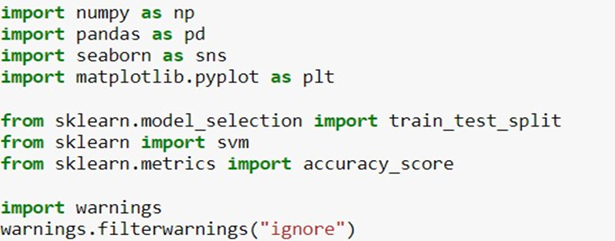
SYSTEM IMPLEMENTATION
Importing the libraries
Figure: Importing Packages

Slide 9
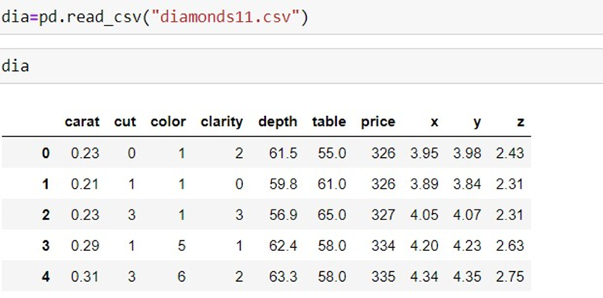
Reading Dataset
Figure: Loading the dataset

Slide 10
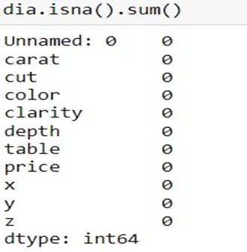
Data Pre-processing
Checking null values

Slide 11
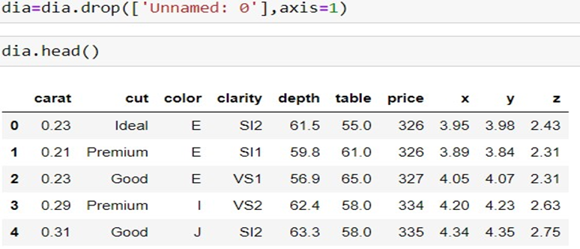
2. Dropping irrelevant columns

Slide 12
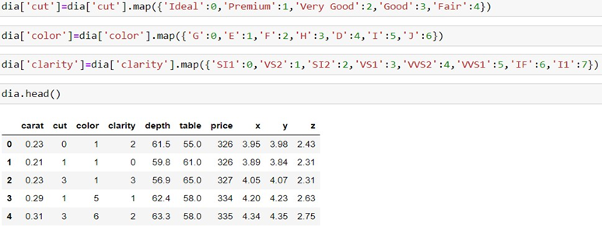
3. Data Encoding

Slide 13
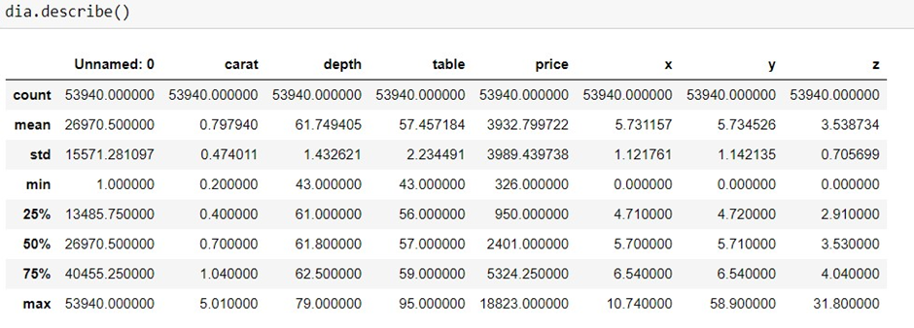
Statistical Description
Figure: Statistical Description

Slide 14
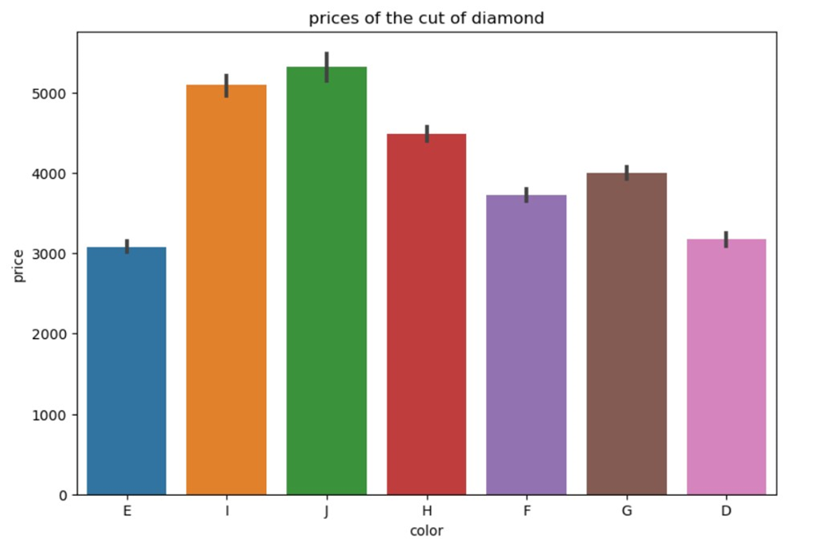
Exploratory Data Analysis (EDA)
Price of the diamond based on color

Slide 15
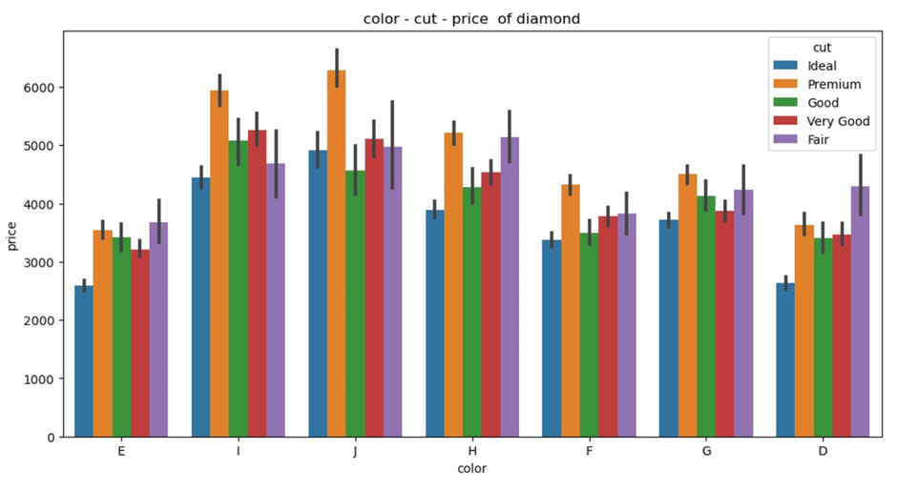
2. Price of the diamond based on color and cut

Slide 16
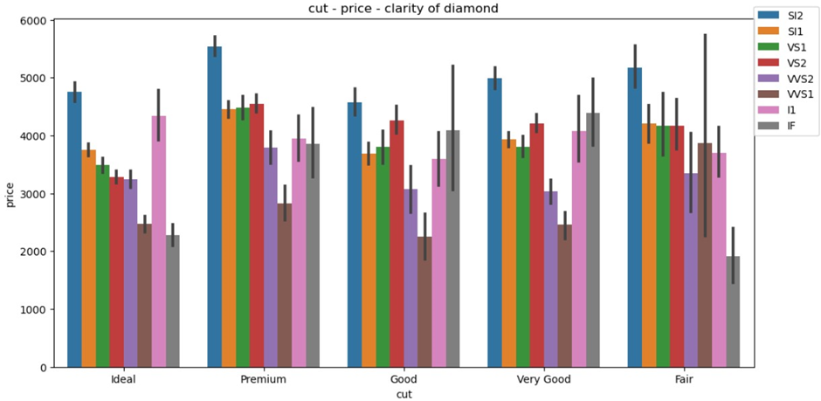
3. Price of the diamond based on clarity and cut

Slide 17
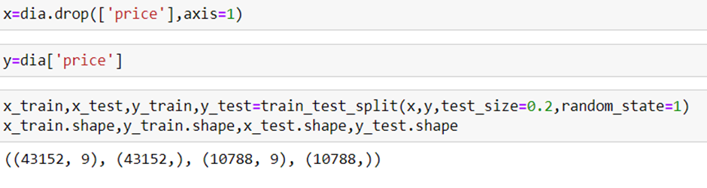
Splitting the dataset into training and test data
Figure: Splitting the dataset

Slide 18
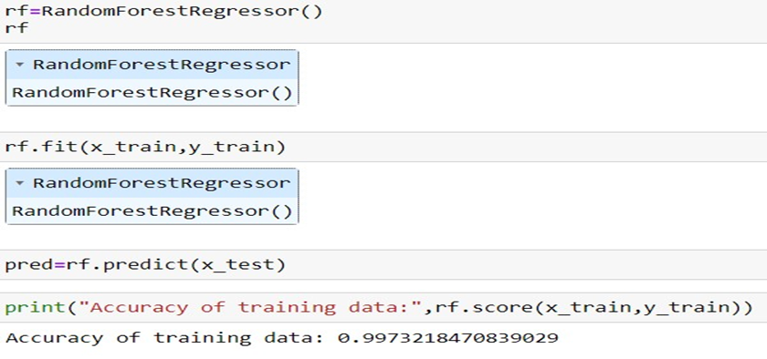
Building Predictive model Random forest Regressor
Figure: Random Forest building and evaluation

Slide 19
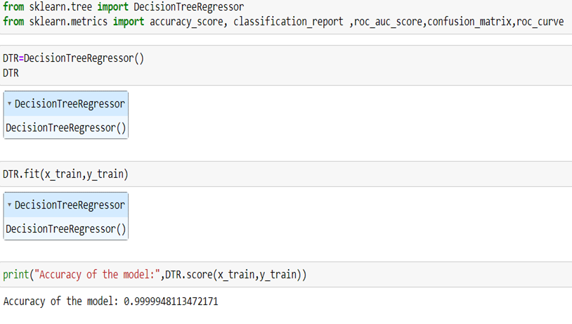
Building Predictive model- Decision Tree Regressor
Figure: Decision Tree building and evaluation

Slide 20
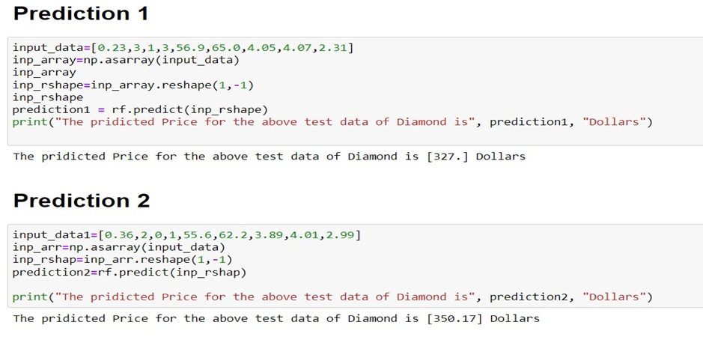
Model Prediction
Figure: Prediction of Random Forest model

Slide 21
CONCLUSION
The proposed method will predict the the price of diamond based on its features and other parameters.
Machine learning presents a promising avenue for diamond price prediction, offering the potential to extract insights from vast datasets and improve forecasting accuracy.
By leveraging techniques such as decision trees, random forest machine learning models can capture complex patterns in diamond pricing data that traditional methods might overlook.

